Slide 1

Cryptography and Network Security - Project
Intrusion Detection using ML
Team Members: Navina G A, Rakshith, Sri Sanjeevi

Slide 2
Intrusion Detection
Intrusion Detection(DS) monitors a network or systems for malicious activity and protects a computer network from unauthorized access from users, including perhaps insider.

Slide 3
Idea Intended:
The motive of this project is to propose a predictive model (i.e. a classifier) capable of distinguishing between 'bad connections' (intrusions/attacks) and a 'good(normal) connections' after applying some feature extraction on KDD Cup 1999 dataset by DARPA.

Slide 4
Dataset:
KDD Cup 1999 dataset
The whole dataset can be downloaded from- http://kdd.ics.uci.ledu/databases/kddcup99/kddcup99.html

Slide 5
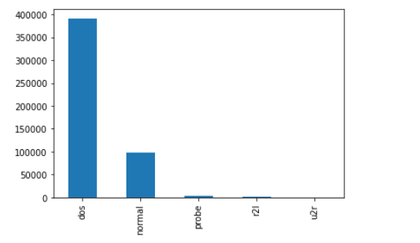
Observations:
Protocol type: We notice that ICMP is the most present in the used data, then TCP and almost 20000 packets of UDP type.
Attack Types: DOS, Normal , Probe, R2F and U2R.

Slide 6
Conclusions:
We used 5 different models to train and classify the data for attacks: Decision Tree appears to be the best
-
Model Name | Training Accuracy | Testing Accuracy
Decision Tree | 0.997 | 0.996
Logistic Regression | 0.993 | 0.993
Gradient Boosting Classifier | 0.995 | 0.995
Random Forest Classifier | 0.86 | 0.86
Support Vector Machines | 0.88 | 0.88

